Slide 1

Method of Moments based on a surface admittance operator (MoM-SO):
An Introduction
Adilton Junio Ladeira PEREIRA
adt@ufmg.br
Programa de Pós-Graduação em Engenharia Elétrica (PPGEE)¹
Belo Horizonte, julho de 2024
¹ Universidade Federal de Minas Gerais – Av. Antônio Carlos 6627. Belo Horizonte, MG, Brasil. 31270-901.

Slide 2

Agenda
Introduction
    Motivation
    Differential Surface Admittance Concept
Circular Conductors Surrounded by a Homogeneous Lossless Medium
    Problem Statement
    Surface Admittance Operator
    Electric Field Integral Equation (EFIE)
    Discrete Green’s Function
p.u.l. Impedance
    Partial p.u.l. Impedance
    Total p.u.l. Impedance
Examples
    Bifilar Line
    Coaxial (single core) Cable

Slide 3
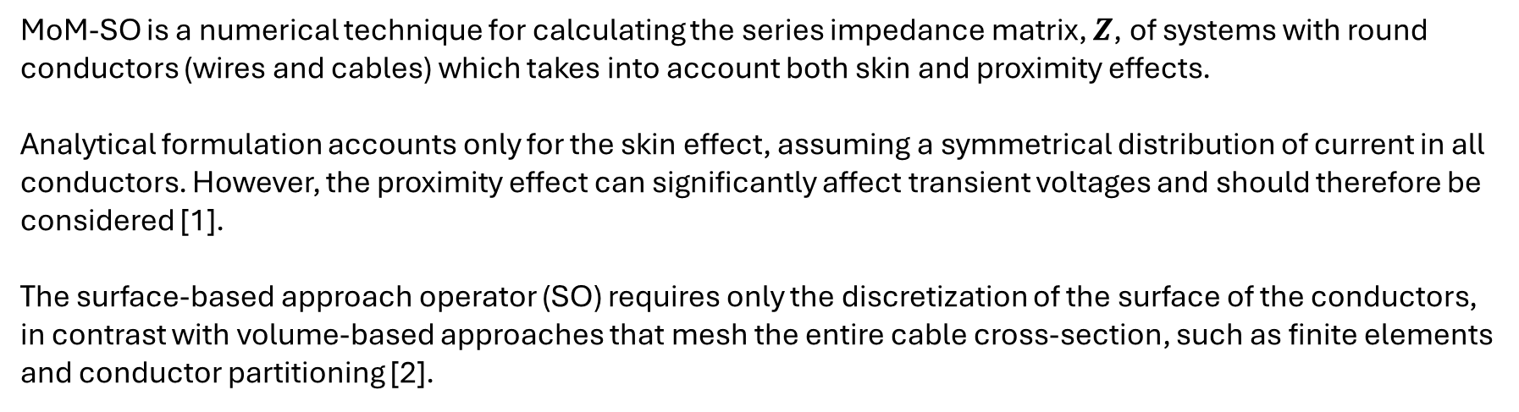
Introduction
Motivation
MoM-SO is a numerical technique for calculating the series impedance matrix, $Z$, of systems with round conductors (wires and cables) which takes into account both skin and proximity effects.
Analytical formulation accounts only for the skin effect, assuming a symmetrical distribution of current in all conductors. However, the proximity effect can significantly affect transient voltages and should therefore be considered [1].
The surface-based approach operator (SO) requires only the discretization of the surface of the conductors, in contrast with volume-based approaches that mesh the entire cable cross-section, such as finite elements and conductor partitioning [2].

Slide 4


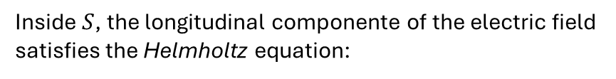



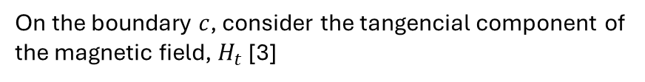

Introduction
Differential Surface Admittance Concept
On the boundary $c$, consider the tangencial component of the magnetic field, $H_{t}$ [3]
$$ε_{0},μ_{0}, σ_{0}$$
$$H_{t}=\frac{1}{jωμ_{0}}∂_{n}E_{z}$$
$$c$$
$$ε_{ },μ_{ }, σ_{ }$$
$$S$$
Inside $S$, the longitudinal componente of the electric field satisfies the Helmholtz equation:
$$a_{n}$$
$$∇^{2}E_{z}+k^{2}E_{z}=0$$
Original Problem
with
$$k=\sqrt{ωμ_{ }(ωε−jσ)}$$

Slide 5

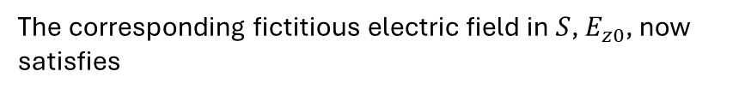




Introduction
Differential Surface Admittance Concept
Applying the Equivalence Principle [4], suppose that the constitutive parameters of the conducting cylinder are replaced by those of the medium outside the conductor.
$$ε_{0},μ_{0}, σ_{0}$$
$$c$$
$$ε_{0},μ_{0}, σ_{0}$$
The corresponding fictitious electric field in $S$, $E_{z0}$, now satisfies
$$S$$
$$∇^{2}E_{z0}+k_{0}^{2}E_{z0}=0$$
$$a_{n}$$
with
$$k_{0}=\sqrt{ωμ_{0}(ωε_{0}−jσ_{0})}$$
Equivalent Problem
$$H_{t0}=\frac{1}{jωμ_{0}}∂_{n}E_{z0}$$

Slide 6





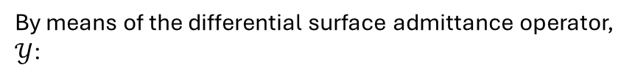

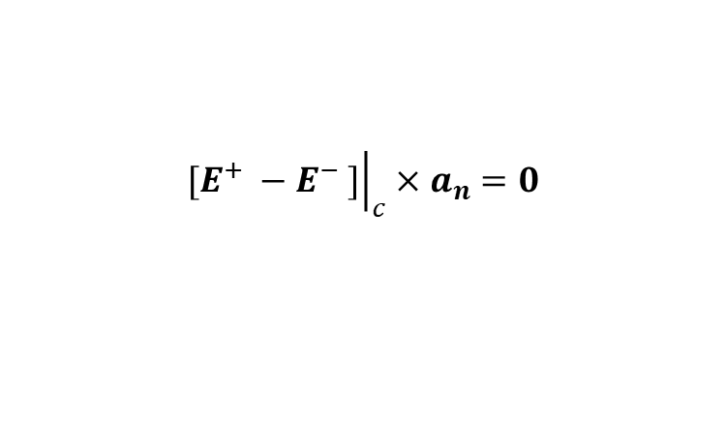

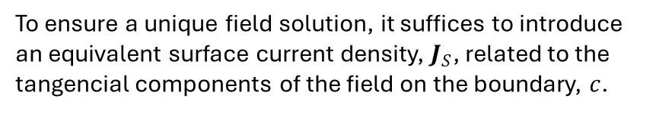


Introduction
Differential Surface Admittance Concept
To ensure a unique field solution, it suffices to introduce an equivalent surface current density, $J_{S}$, related to the tangencial components of the field on the boundary, $c$.
$$ε_{0},μ_{0}, σ_{0}$$
$$J_{s}=H_{t} −H_{t0}=\frac{1}{jωμ_{0}}[∂_{n}E_{z}−∂_{n}E_{z0}]$$
$$c$$
$$ε_{0},μ_{0}, σ_{0}$$
$$J_{s}$$
By means of the differential surface admittance operator, $𝒴$:
$$S$$
$$J_{s}= 𝒴 E_{z0}$$
$$a_{n}$$
$$𝒴=\frac{1}{jωμ_{0}}[𝒟_{k}−𝒟_{k0}]$$
Equivalent Problem
$${\left.a_{n}×{\left.[H^{+} −H^{−} ]\right|}_{c}=J_{s}\right|}_{c}$$
The Dirichlet–Neumann operators, $𝒟_{k}$and $𝒟_{k0}$, establish the boundary conditions on $c$ in relation to the values of the normal derivatives of the fields [3].
$${\left.[E^{+} −E^{−} ]\right|}_{c}×a_{n}=0$$

Slide 7



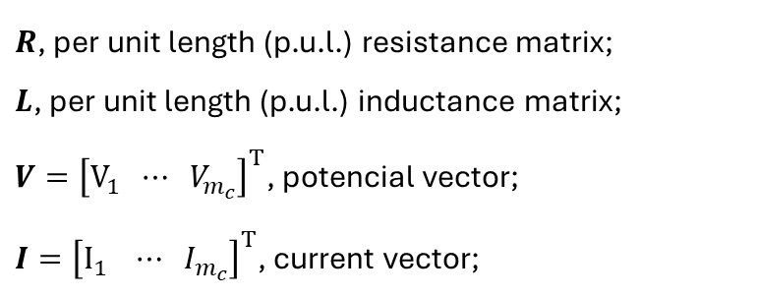



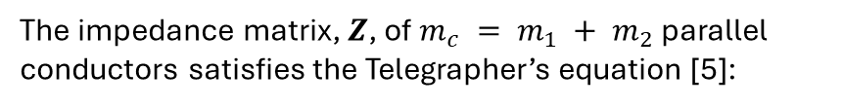

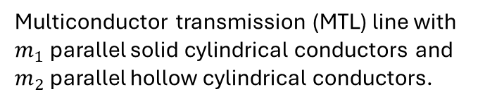

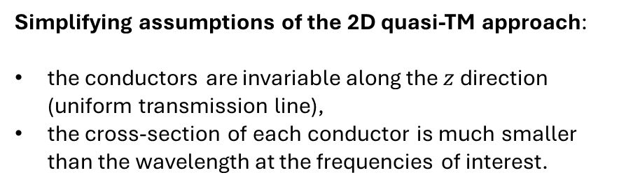
Circular Conductors Surrounded by a Homogeneous Lossless Medium
Problem Statement
$$ε_{0},μ_{0}$$
The impedance matrix, $Z$, of $m_{c} = m_{1} + m_{2}$ parallel conductors satisfies the Telegrapher’s equation [5]:
$$b_{q}$$
$$a_{p}$$
$$a_{q}$$
$$\frac{∂V}{∂z}=−\left[R\left(ω\right)+jωL\left(ω\right)\right]I$$
$$(1)$$
$$ε_{p},μ_{p}, σ_{p}$$
$$ε_{q},μ_{q}, σ_{q}$$
$R$, per unit length (p.u.l.) resistance matrix;
$L$, per unit length (p.u.l.) inductance matrix;
$V={\left[V_{1} ⋯ V_{m_{c}}\right]}^{T}$, potencial vector;
$I={\left[I_{1} ⋯ I_{m_{c}}\right]}^{T}$, current vector;
Multiconductor transmission (MTL) line with $m_{1}$ parallel solid cylindrical conductors and $m_{2}$ parallel hollow cylindrical conductors.
Simplifying assumptions of the 2D quasi-TM approach:
the conductors are invariable along the $z$ direction (uniform transmission line),
the cross-section of each conductor is much smaller than the wavelength at the frequencies of interest.

Slide 8
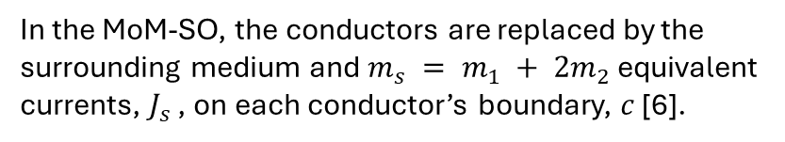

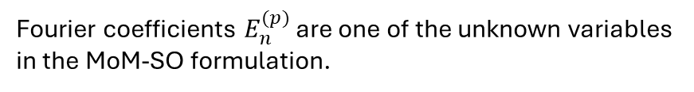


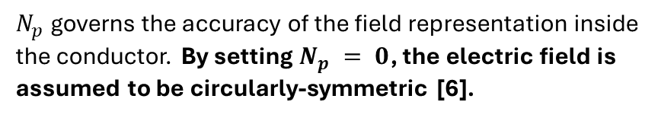





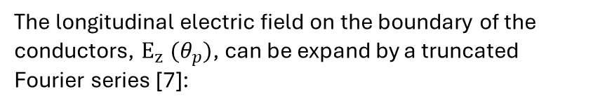



Circular Conductors Surrounded by a Homogeneous Lossless Medium
Surface Admittance Operator of the MTL
The longitudinal electric field on the boundary of the conductors, $E_{z}^{ } (θ_{p})$, can be expand by a truncated Fourier series [7]:
$$c_{p}$$
$$ε_{0},μ_{0}$$
$$c_{q}$$
$$E_{z}^{\left(p\right)}(θ_{p})=\sum_{n=−N_{p}}^{N_{p}}{E_{n}^{(p)}e^{jnθ_{p}}}$$
$$c_{r}$$
$$(2)$$
$$J_{s}^{(p)}$$
$$a_{p}$$
$$a_{r}$$
$$a_{q}$$
$$J_{s}^{(q)}$$
$$J_{s}^{(r)}$$
$N_{p}$ governs the accuracy of the field representation inside the conductor. By setting $N_{p} = 0$, the electric field is assumed to be circularly-symmetric [6].
Fourier coefficients $E_{n}^{(p)}$ are one of the unknown variables in the MoM-SO formulation.
In the MoM-SO, the conductors are replaced by the surrounding medium and $m_{s} = m_{1} + 2m_{2}$ equivalent currents, $J_{s}^{ }$ , on each conductor’s boundary, $c$ [6].

Slide 9

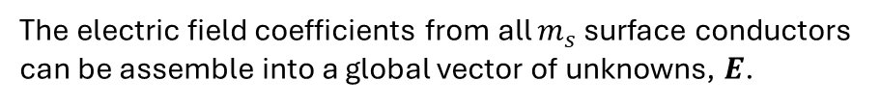

Circular Conductors Surrounded by a Homogeneous Lossless Medium
Surface Admittance Operator of the MTL
If $p$th-conductor is solid,
$$E^{(p)}={\left[E_{ −N_{p}}^{\left(p\right)}⋯E_{ 0}^{\left(p\right)}⋯E_{ N_{p}}^{\left(p\right)}\right]}^{T}$$
$$c_{p}$$
$$ε_{0},μ_{0}$$
$$c_{q}$$
$$c_{r}$$
otherwise, if $q$th-conductor is hollow then,
$$J_{s}^{(p)}$$
$$E^{(q)}={\left[E_{ −N_{r}}^{\left(r\right)}⋯E_{ 0}^{\left(r\right)}⋯E_{ N_{r}}^{\left(r\right)} E_{ −N_{q}}^{\left(q\right)}⋯E_{ 0}^{\left(q\right)}⋯E_{ N_{q}}^{\left(q\right)}\right]}^{T}$$
$$a_{p}$$
$$a_{r}$$
$$a_{q}$$
$$J_{s}^{(q)}$$
$$J_{s}^{(r)}$$
The electric field coefficients from all $m_{s}$ surface conductors can be assemble into a global vector of unknowns, $E$.
$$E={\left[E_{ }^{\left(1\right)} E_{ }^{(2)} ⋯E_{ }^{(m_{s})}\right]}^{T}$$
The size of $E$ is $N×1$, where
$$N=\sum_{p=1}^{m_{s}}{\left(2N_{p}+1\right)}$$
$$(3)$$

Slide 10
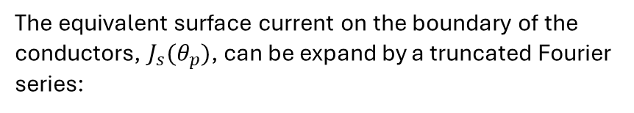
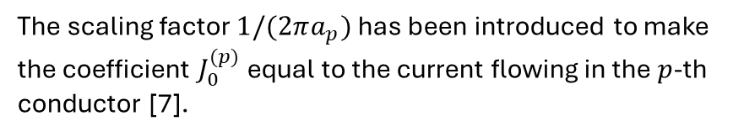


Circular Conductors Surrounded by a Homogeneous Lossless Medium
Surface Admittance Operator of the MTL
The equivalent surface current on the boundary of the conductors, $J_{s}^{ }(θ_{p})$, can be expand by a truncated Fourier series:
$$c_{p}$$
$$ε_{0},μ_{0}$$
$$c_{q}$$
$$J_{s}^{\left(p\right)}(θ_{p})=\frac{1}{2πa_{p}}\sum_{n=−N_{p}}^{N_{p}}{J_{n}^{(p)}e^{jnθ_{p}}}$$
$$c_{r}$$
$$(4)$$
$$J_{s}^{(p)}$$
$$a_{p}$$
$$a_{r}$$
$$a_{q}$$
$$J_{s}^{(q)}$$
$$J_{s}^{(r)}$$
The scaling factor $1/(2πa_{p})$ has been introduced to make the coefficient $J_{0}^{(p)}$ equal to the current flowing in the $p$-th conductor [7].
In a similar manner, we collect all the Fourier coefficients of the equivalent currents into a global vector
$$J={\left[J_{ }^{\left(1\right)} J_{ }^{(2)} ⋯J_{ }^{(m_{s})}\right]}^{T}$$

Slide 11
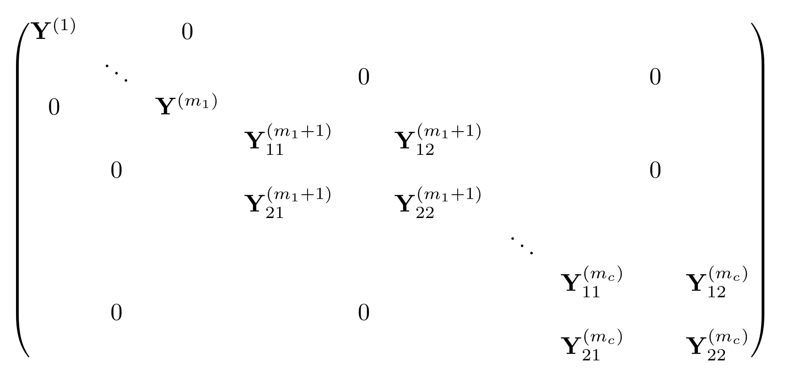


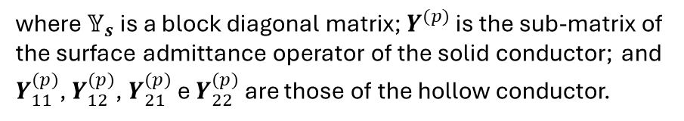




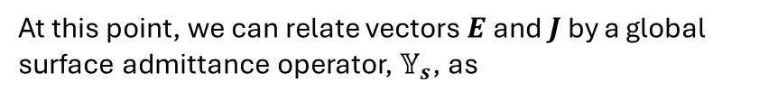
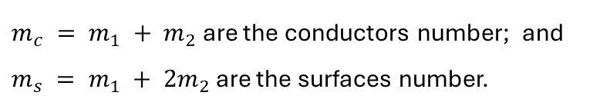
Circular Conductors Surrounded by a Homogeneous Lossless Medium
Surface Admittance Operator of the MTL
At this point, we can relate vectors $E$ and $J$ by a global surface admittance operator, $𝕐_{s}$, as
$$c_{p}$$
$$c_{q}$$
$$J=𝕐_{s} E$$
$$(5)$$
$$ε_{0},μ_{0}$$
$$𝕐_{s}=$$
$$c_{r}$$
$$J_{s}^{(p)}$$
$$a_{p}$$
$$a_{r}$$
$$a_{q}$$
$$J_{s}^{(q)}$$
$$J_{s}^{(r)}$$
$m_{1}$ solid conductors
$m_{2}$ hollow conductors
$$N×N$$
Recalling that,
where $𝕐_{s}$ is a block diagonal matrix; $Y^{(p)}$ is the sub-matrix of the surface admittance operator of the solid conductor; and $Y_{11}^{(p)}$, $Y_{12}^{(p)}$, $Y_{21}^{(p)}$ e $Y_{22}^{(p)}$ are those of the hollow conductor.
$m_{c} = m_{1} + m_{2}$ are the conductors number; and $m_{s} = m_{1} + 2m_{2}$ are the surfaces number.

Slide 12
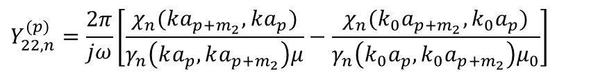
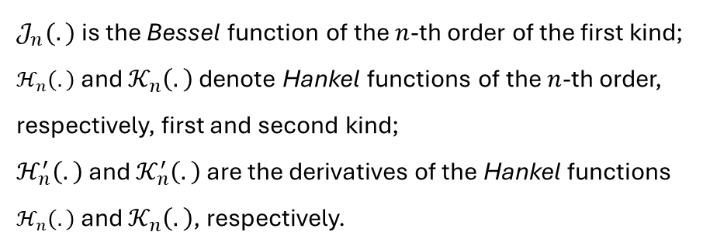
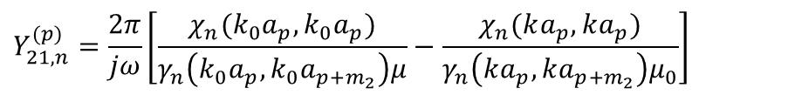
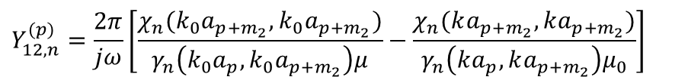
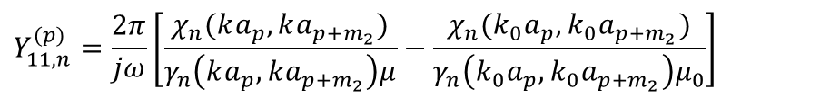
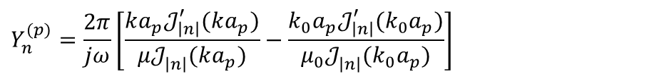

Circular Conductors Surrounded by a Homogeneous Lossless Medium
Surface Admittance Operator of the MTL
$Y^{(p)}$, $Y_{11}^{(p)}$, $Y_{12}^{(p)}$, $Y_{21}^{(p)}$ e $Y_{22}^{(p)}$ are diagonal matrices with entries:
$$Y_{n}^{(p)}={\frac{2π}{jω}\left[\frac{ka_{p}𝒥_{\left|n\right|}^{′}(ka_{p})}{μ𝒥_{\left|n\right|}^{ }(ka_{p})}−\frac{k_{0}a_{p}𝒥_{\left|n\right|}^{′}(k_{0}a_{p})}{μ_{0}𝒥_{\left|n\right|}^{ }(k_{0}a_{p})}\right]}^{ }$$
$$χ_{n}(α, β)={β\left[ℋ_{\left|n\right|}^{′}(β)𝒦_{\left|n\right|}^{ }(α)−ℋ_{\left|n\right|}^{ }(α)𝒦_{\left|n\right|}^{′}(β)\right]}^{ }$$
$$γ_{n}(α, β)={ℋ_{\left|n\right|}^{ }\left(α\right)𝒦_{\left|n\right|}^{ }\left(β\right)−ℋ_{\left|n\right|}^{ }(β)𝒦_{\left|n\right|}^{ }(α)}^{ }$$
$$Y_{11,n}^{(p)}={\frac{2π}{jω}\left[\frac{χ_{n}(ka_{p},ka_{p+m_{2}})}{γ_{n}\left(ka_{p},ka_{p+m_{2}}\right)μ}−\frac{χ_{n}(k_{0}a_{p},k_{0}a_{p+m_{2}})}{γ_{n}\left(k_{0}a_{p},k_{0}a_{p+m_{2}}\right)μ_{0}}\right]}^{ }$$
$k=\sqrt{ωμ(ωε−jσ)}$, $k_{0}=ω\sqrt{μ_{0}ε_{0}}$
$$Y_{12,n}^{(p)}={\frac{2π}{jω}\left[\frac{χ_{n}(k_{0}a_{p+m_{2}},k_{0}a_{p+m_{2}})}{γ_{n}\left(k_{0}a_{p},k_{0}a_{p+m_{2}}\right)μ}−\frac{χ_{n}(ka_{p+m_{2}}, ka_{p+m_{2}})}{γ_{n}\left(ka_{p},ka_{p+m_{2}}\right)μ_{0}}\right]}^{ }$$
$𝒥_{n}^{ }(.)$is the Bessel function of the $n$-th order of the first kind;
$ℋ_{n}^{ }\left(.\right)$ and $𝒦_{n}^{ }\left(.\right)$ denote Hankel functions of the $n$-th order, respectively, first and second kind;
$ℋ_{n}^{′}\left(.\right)$ and $𝒦_{n}^{′}\left(.\right)$ are the derivatives of the Hankel functions $ℋ_{n}^{ }\left(.\right)$ and $𝒦_{n}^{ }\left(.\right)$, respectively.
$$Y_{21,n}^{(p)}={\frac{2π}{jω}\left[\frac{χ_{n}(k_{0}a_{p},k_{0}a_{p})}{γ_{n}\left(k_{0}a_{p},k_{0}a_{p+m_{2}}\right)μ}−\frac{χ_{n}(ka_{p}, ka_{p})}{γ_{n}\left(ka_{p},ka_{p+m_{2}}\right)μ_{0}}\right]}^{ }$$
$$Y_{22,n}^{(p)}={\frac{2π}{jω}\left[\frac{χ_{n}(ka_{p+m_{2}},ka_{p})}{γ_{n}\left(ka_{p},ka_{p+m_{2}}\right)μ}−\frac{χ_{n}(k_{0}a_{p+m_{2}},k_{0}a_{p})}{γ_{n}\left(k_{0}a_{p},k_{0}a_{p+m_{2}}\right)μ_{0}}\right]}^{ }$$
for $n=−N_{p}, …, N_{p}$

Slide 13






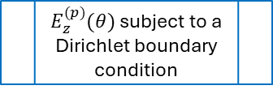

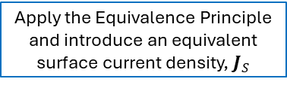


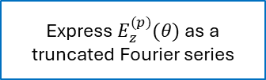
Circular Conductors Surrounded by a Homogeneous Lossless Medium
Surface Admittance Operator of the MTL
$$c_{p}$$
$$c_{q}$$
Multiconductor
Transmission Line
$$ε_{0},μ_{0}$$
$$c_{r}$$
$$J_{s}^{(p)}$$
$$a_{p}$$
$$a_{r}$$
$E_{z}^{(p)}(θ)$ subject to a Dirichlet boundary condition
$$J_{s}^{(q)}$$
Apply the Equivalence Principle and introduce an equivalent surface current density, $J_{S}$
$$a_{q}$$
$$J_{s}^{(r)}$$
Express $E_{z}^{(p)}(θ)$ as a truncated Fourier series
Express $J_{s}^{(p)}(θ)$ as a truncated Fourier series
In essence, the surface admittance concept is a simpler representation of the conductor which will allow us to simplify our original problem, just like Norton theorem helps simplify a circuit.
Using the surface admittance relationship, one can replace the conductor by an equivalent current source. Analogously, the surface admittance operator is the ratio of equivalent current and the electric fields on the boundary of the conductor.
Apply the boundary conditions to the tangential field components (Uniqueness Theorem)
$$J=𝕐_{s} E$$

Slide 14


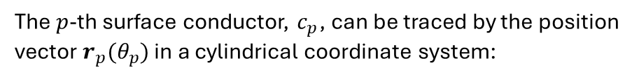

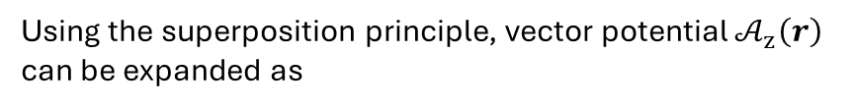
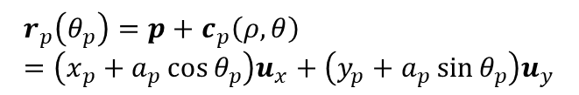





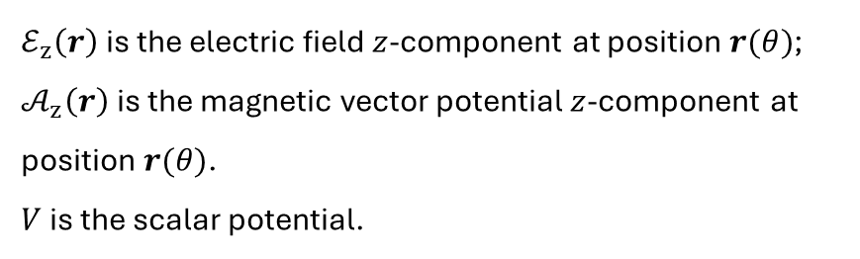



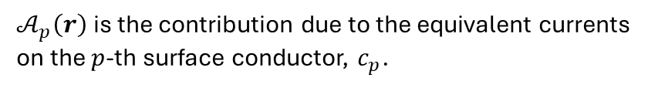

Circular Conductors Surrounded by a Homogeneous Lossless Medium
Electric Field Integral Equation (EFIE)
The effect of the equivalent current sources onto surrounding medium is modelled with the Electric Field Integral Equation (EFIE):
$$c_{p}$$
$$a_{p}$$
$$J_{s}^{(p)}$$
$$θ_{p}$$
$$ℰ_{z}^{ }\left(r\right)=−jω𝒜_{z}\left(r\right)−\frac{∂V}{∂z}$$
$$r_{p}$$
$$(6)$$
$${(x}_{p}, y_{p})$$
$ℰ_{z}^{ }\left(r\right)$ is the electric field $z$-component at position $r(θ)$;
$𝒜_{z}^{ }\left(r\right)$is the magnetic vector potential $z$-component at position $r(θ)$.
$V$ is the scalar potential.
$$p$$
$$O$$
The $p$-th surface conductor, $c_{p}$, can be traced by the position vector $r_{p}(θ_{p})$ in a cylindrical coordinate system:
$$p=x_{p}u_{x}+y_{p}u_{y}$$
Using the superposition principle, vector potential $𝒜_{z}^{ }\left(r\right)$ can be expanded as
$$c_{p}\left(ρ,θ\right)=ρ_{p}u_{ρ}+θ_{p}u_{θ}=a_{p}(\cos{θ_{p}}u_{x}+\sin{θ_{p}}u_{y})$$
$$𝒜_{z}^{ }\left(r\right)=\sum_{p=1}^{m_{s}}{𝒜_{p}^{ }\left(r\right)}$$
$$r_{p}\left(θ_{p}\right)=p+c_{p}\left(ρ,θ\right)=\left(x_{p}+a_{p}\cos{θ_{p}}\right)u_{x}+\left(y_{p}+a_{p}\sin{θ_{p}}\right)u_{y}$$
$𝒜_{p}^{ }\left(r\right)$ is the contribution due to the equivalent currents on the $p$-th surface conductor, $c_{p}$.

Slide 15

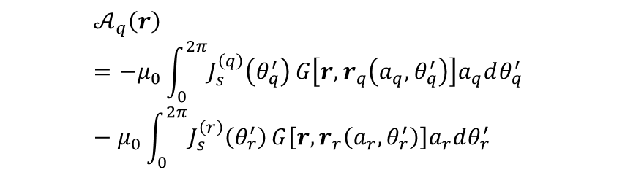



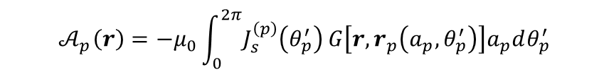


Circular Conductors Surrounded by a Homogeneous Lossless Medium
Electric Field Integral Equation (EFIE)
If conductor $p$ is solid, then
Consider the frequency independent (quasi-static) Green’s function of a two-dimensional homogeneous space:
$$𝒜_{p}^{ }\left(r\right)=−μ_{0}\int_{0}^{2π}{J_{s}^{\left(p\right)}\left(θ_{p}^{′}\right)}G\left[r,r_{p}\left(a_{p},θ_{p}^{′}\right)\right]a_{p}dθ_{p}^{′}$$
$$G\left[r,r^{′}\right]=\frac{1}{2π}\ln{|r−r^{′}|}$$
$$(7)$$
while, if conductor $q$ is hollow
$$𝒜_{q}^{ }\left(r\right)=−μ_{0}\int_{0}^{2π}{J_{s}^{\left(q\right)}\left(θ_{q}^{′}\right)}G\left[r,r_{q}\left(a_{q},θ_{q}^{′}\right)\right]a_{q}dθ_{q}^{′} −μ_{0}\int_{0}^{2π}{J_{s}^{\left(r\right)}\left(θ_{r}^{′}\right)}G\left[r,r_{r}\left(a_{r},θ_{r}^{′}\right)\right]a_{r}dθ_{r}^{′}$$
The quasi-static Green’s function is only accurate when [7]:
the cross-section of the cable is much smaller than a wave-length, so that the retardation effect may be neglected (the smallest wavelength of interest is 30 m at 10 MHz); and
the surrounding medium is lossless.
$$c_{q}$$
$$c_{r}$$
$$a_{r}$$
$$a_{q}$$
$$J_{s}^{(q)}$$
$$J_{s}^{(r)}$$

Slide 16
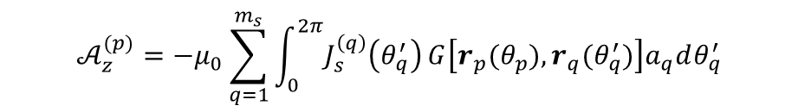
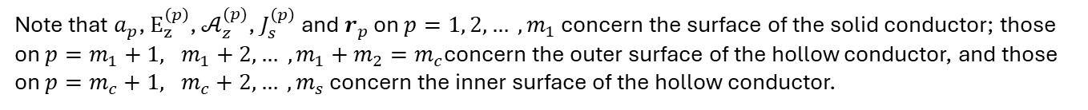



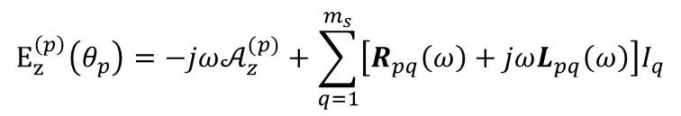
Circular Conductors Surrounded by a Homogeneous Lossless Medium
Electric Field Integral Equation (EFIE)
$$E_{z}^{\left(p\right)}(θ_{p})=−jω𝒜_{z}^{(p)}−\frac{∂V_{p}}{∂z}$$
On the boundary of the $p$-th conductor, $ℰ_{z}^{ }\left(r\right)$ reads:
Relating the potential drop $∂V_{p}/∂z$ to the p.u.l. impedance parameters through the Telegrapher’s equation:
$$E_{z}^{\left(p\right)}\left(θ_{p}\right)=−jω𝒜_{z}^{(p)}+\sum_{q=1}^{m_{s}}{\left[R_{pq}\left(ω\right)+jωL_{pq}\left(ω\right)\right]I_{q}}$$
The main goal is to solve the p.u.l. impedance parameters, which will be done numerically by the MoM using the Fourier series expansions.
$$(8)$$
$R_{pq}\left(ω\right)$and $L_{pq}\left(ω\right)$represent the $(p, q)$entry of the p.u.l. resistance and inductance matrices, respectively; and
$$𝒜_{z}^{(p)}=−μ_{0}\sum_{q=1}^{m_{s}}{\int_{0}^{2π}{J_{s}^{\left(q\right)}\left(θ_{q}^{′}\right)}G\left[r_{p}(θ_{p}),r_{q}(θ_{q}^{′})\right]a_{q}dθ_{q}^{′}}$$
Note that $a_{p}$, $E_{z}^{\left(p\right)}$, $𝒜_{z}^{(p)}$, $J_{s}^{\left(p\right)}$and $r_{p}$ on $p=1, 2, … , m_{1}$ concern the surface of the solid conductor; those on $p=m_{1}+1, m_{1}+2, … , m_{1}+m_{2}=m_{c}$concern the outer surface of the hollow conductor, and those on $p=m_{c}+1, m_{c}+2, … , m_{s}$ concern the inner surface of the hollow conductor.

Slide 17
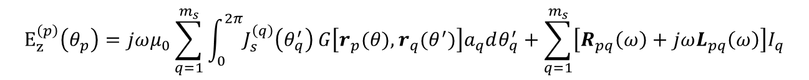

Circular Conductors Surrounded by a Homogeneous Lossless Medium
Discrete Green’s Function
Given an multiconductor cylindrical geometry, one can approximate the field and the current on the $p$-th surface conductor by means of a truncated Fourier series:
$$E_{z}^{\left(p\right)}\left(θ_{p}\right)=jωμ_{0}\sum_{q=1}^{m_{s}}{\int_{0}^{2π}{J_{s}^{\left(q\right)}\left(θ_{q}^{′}\right)}G\left[r_{p}(θ),r_{q}(θ^{′})\right]a_{q}dθ_{q}^{′}}+\sum_{q=1}^{m_{s}}{\left[R_{pq}\left(ω\right)+jωL_{pq}\left(ω\right)\right]I_{q}}$$
$$\sum_{n=−N_{p}}^{N_{p}}{E_{n}^{(p)}e^{jnθ_{p}}}=jωμ_{0}\sum_{q=1}^{m_{s}}{\int_{0}^{2π}{\frac{1}{2πa_{q}}\sum_{n=−N_{q}}^{N_{q}}{J_{n}^{(q)}e^{jnθ_{q}^{′}}}}G\left[r_{p}(θ),r_{q}(θ^{′})\right]a_{q}dθ_{q}^{′}}+\sum_{q=1}^{m_{s}}{\left[R_{pq}\left(ω\right)+jωL_{pq}\left(ω\right)\right]I_{q}}$$
$$\sum_{n=−N_{p}}^{N_{p}}{E_{n}^{(p)}e^{jnθ_{p}}}=\frac{jωμ_{0}}{2π}\sum_{q=1}^{m_{s}}{\sum_{n=−N_{q}}^{N_{q}}{J_{n}^{(q)}}\int_{0}^{2π}{G\left[r_{p}(a_{p},θ_{p}),r_{q}(a_{q},θ_{q}^{′})\right]e^{jnθ_{q}^{′}}dθ_{q}^{′}}}+\sum_{q=1}^{m_{s}}{\left[R_{pq}\left(ω\right)+jωL_{pq}\left(ω\right)\right]I_{q}}$$
$$(9)$$

Slide 18

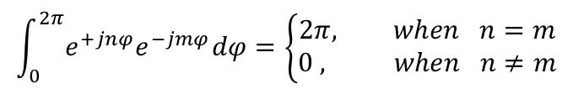

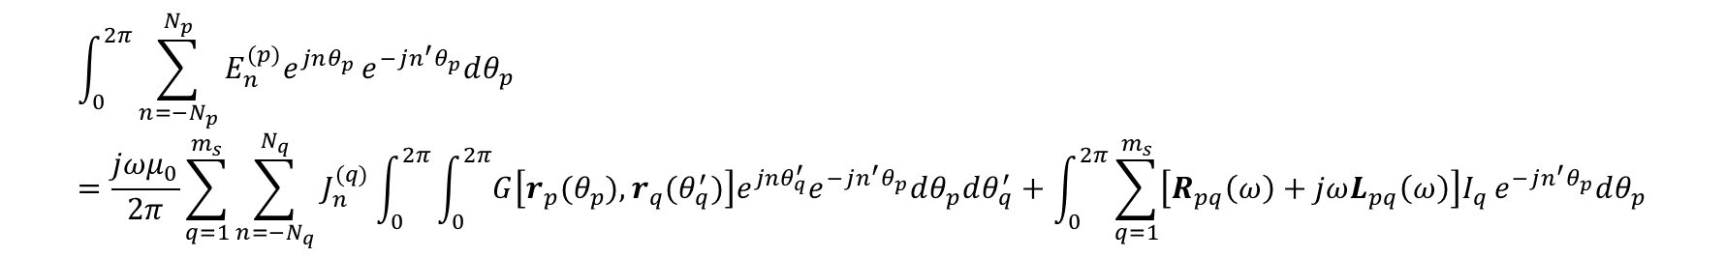
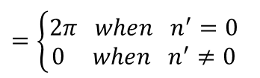
Circular Conductors Surrounded by a Homogeneous Lossless Medium
Discrete Green’s Function
Applying the Galerkin method and using the orthogonality relationship $\int_{0}^{2π}{\left[.\right]e^{−jn^{′}θ_{p}^{ }}dθ_{p}}$ to both sides of $\left(9\right)$:
$$\int_{0}^{2π}{e^{+jnφ}e^{−jmφ}dφ}=\left\{\begin{aligned}2π, when n=m \\ 0 , when n≠m\end{aligned}\right.$$
$$\int_{0}^{2π}{\sum_{n=−N_{p}}^{N_{p}}{E_{n}^{(p)}e^{jnθ_{p}}}e^{−jn^{′}θ_{p}^{ }}dθ_{p}^{ }}=\frac{jωμ_{0}}{2π}\sum_{q=1}^{m_{s}}{\sum_{n=−N_{q}}^{N_{q}}{J_{n}^{(q)}}\int_{0}^{2π}{\int_{0}^{2π}{G\left[r_{p}(θ_{p}),r_{q}(θ_{q}^{′})\right]e^{jnθ_{q}^{′}}e^{−jn^{′}θ_{p}^{ }}dθ_{p}^{ }dθ_{q}^{′}}}}+\int_{0}^{2π}{\sum_{q=1}^{m_{s}}{\left[R_{pq}\left(ω\right)+jωL_{pq}\left(ω\right)\right]I_{q}}e^{−jn^{′}θ_{p}^{ }}dθ_{p}^{ }}$$
$$2π E_{n}^{(p)}=\frac{jωμ_{0}}{2π}\sum_{q=1}^{m_{s}}{\sum_{n=−N_{q}}^{N_{q}}{J_{n}^{(q)}}\int_{0}^{2π}{\int_{0}^{2π}{G\left[r_{p}(θ_{p}),r_{q}(θ_{q}^{′})\right]e^{j(nθ_{q}^{′}−n^{′}θ_{p}^{ })}dθ_{p}^{ }dθ_{q}^{′}}}}+\sum_{q=1}^{m_{s}}{\left[R_{pq}\left(ω\right)+jωL_{pq}\left(ω\right)\right]I_{q}}\int_{0}^{2π}{e^{−jn^{′}θ_{p}^{ }}dθ_{p}^{ }}$$
Matrix $G_{ }^{(p, q)}$
$$=\left\{\begin{aligned}2π when n^{′}=0 \\ 0 when n^{′}≠0\end{aligned}\right.$$

Slide 19




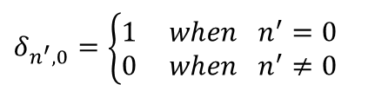
Circular Conductors Surrounded by a Homogeneous Lossless Medium
Discrete Green’s Function
Matrix $G_{ }^{(p, q)}$ describes the contribution of the equivalent current on $q$-th conductor to the field on the boundary of the $p$-th conductor. $G_{n^{′}, n}^{(p, q)}$denotes the $(n^{′}, n)$entry of the matrix $G_{ }^{(p, q)}$, given by the double integral:
$$G_{n^{′}, n}^{(p, q)}=\frac{1}{{\left(2π\right)}^{2}}\int_{0}^{2π}{\int_{0}^{2π}{G\left[r_{p}(θ_{p}),r_{q}(θ_{q}^{′})\right]e^{j(nθ_{ }^{′}−n^{′}θ)}dθ_{p}^{ }dθ_{q}^{′}}}$$
$$(10)$$
which may be evaluated analytically [7]. Then, the field on the $p$-th surface conductor can be compactly written as:
$$E_{n^{′}}^{(p)}=jωμ_{0}\sum_{q=1}^{m_{s}}{\sum_{n=−N_{q}}^{N_{q}}{J_{n}^{(q)}}G_{n^{′}, n}^{(p, q)}}+δ_{n^{′}, 0} \sum_{q=1}^{m_{s}}{\left[R_{pq}\left(ω\right)+jωL_{pq}\left(ω\right)\right]I_{q}}$$
$$(p=1, …, m_{s})$$
$$(11)$$
$$δ_{n^{′}, 0}=\left\{\begin{aligned}1 when n^{′}=0 \\ 0 when n^{′}≠0\end{aligned}\right.$$
Using the matrix notation, $(11)$can be rewrite as
$$E=jωμ_{0}𝔾J+𝕌\left[R\left(ω\right) +jωL\left(ω\right)\right]I$$
$$(12)$$

Slide 20




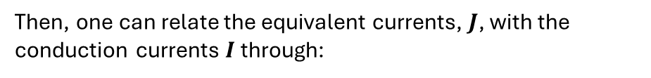

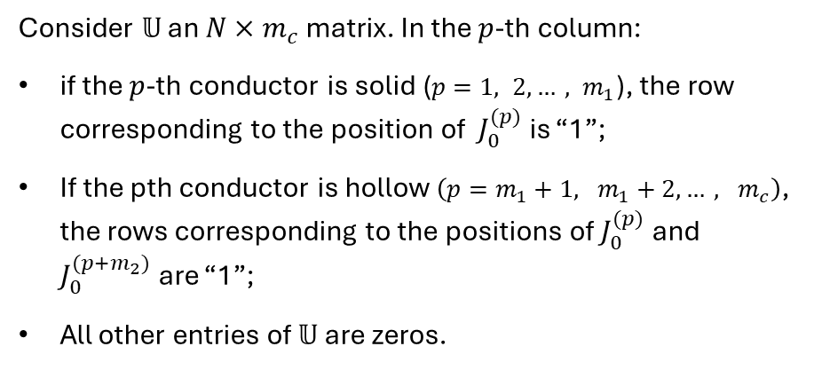

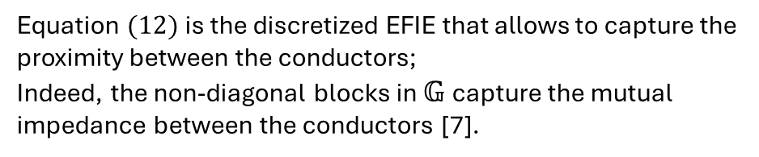

Circular Conductors Surrounded by a Homogeneous Lossless Medium
Discrete Green’s Function
$$E=jωμ_{0}𝔾J+𝕌\left[R\left(ω\right) +jωL\left(ω\right)\right]I$$
$$(12)$$
Consider $𝕌$ an $N×m_{c}$ matrix. In the $p$-th column:
if the $p$-th conductor is solid ($p=1, 2, …, m_{1}$), the row corresponding to the position of $J_{0}^{(p)}$is “1”;
If the pth conductor is hollow $\left(p=m_{1}+1, m_{1}+2, …, m_{c}\right)$, the rows corresponding to the positions of $J_{0}^{(p)}$and $J_{0}^{(p+m_{2})}$ are “1”;
All other entries of $𝕌$ are zeros.
Global matrix $𝔾$ is obtained by the discretization of Green’s function and given by
$$𝔾=\left(\begin{matrix}G_{ }^{(1, 1)} & ⋯ & G_{ }^{(1,{ m}_{s})} \\ ⋮ & ⋱ & ⋮ \\ G_{ }^{(m_{s}, 1)} & ⋯ & G_{ }^{(m_{s}, m_{s})}\end{matrix}\right)$$
$$N×N$$
$$G_{ }^{(p, q)}=\left(\begin{matrix}G_{−N_{p}, −N_{q}}^{(p, q)} & ⋯ & G_{−N_{p}, N_{q}}^{(p, q)} \\ ⋮ & ⋱ & ⋮ \\ G_{N_{p}, −N_{q}}^{(p, q)} & ⋯ & G_{N_{p}, N_{q}}^{(p, q)}\end{matrix}\right)$$
Then, one can relate the equivalent currents, $J$, with the conduction currents $I$ through:
$$2N_{p}+1×2N_{q}+1$$
Equation $(12)$ is the discretized EFIE that allows to capture the proximity between the conductors;
Indeed, the non-diagonal blocks in $𝔾$capture the mutual impedance between the conductors [7].
$$I=𝕌^{T}J$$

Slide 21
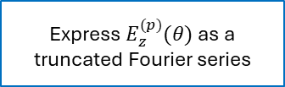








Circular Conductors Surrounded by a Homogeneous Lossless Medium
Discrete Green’s Function
Multiconductor
Transmission Line
$$𝔾, 𝕌$$
EFIE
Telegrapher’s equation
$E_{z}^{(p)}(θ)$ subject to a Dirichlet boundary condition
Apply the Equivalence Principle and introduce an equivalent surface current density, $J_{S}$
p.u.l. Impedance
$$R\left(ω\right) +jωL\left(ω\right)$$
Express $E_{z}^{(p)}(θ)$ as a truncated Fourier series
Express $J_{s}^{(p)}(θ)$ as a truncated Fourier series
Unknown Quantities: $E$, $J$, $Z\left(ω\right)=R\left(ω\right)+jωL(ω)$
Apply the boundary conditions to the tangential field components (Uniqueness Theorem)
MoM
$$E=jωμ_{0}𝔾J+𝕌\left[R\left(ω\right) +jωL\left(ω\right)\right]I$$
$$J=𝕐_{s} E$$

Slide 22









p.u.l. Impedance
Partial p.u.l. Impedance
The partial p.u.l. parameters can be computed by combining the surface admittance relation and the discretized EFIE.
Since all materials in the cable are linear, the p.u.l. impedance must be independent from the current flowing in the conductors.
Hence, the expression inside the square bracket on the right-hand side of $(13)$ must be equal to the identity matrix.
$$J=𝕐_{s} E$$
$$(5)$$
$$E=jωμ_{0}𝔾J+𝕌\left[R\left(ω\right) +jωL\left(ω\right)\right]I$$
$$(12)$$
First left multiply $(12)$ by $𝕐_{s}$, and use $(5)$ to obtain:
$$R\left(ω\right) +jωL\left(ω\right)={\left[𝕌^{T}{\left(1−jωμ_{0}𝕐_{s}𝔾\right)}^{−1}𝕐_{s}𝕌\right]}^{−1}$$
$$(14)$$
$$J=jωμ_{0}𝕐_{s}𝔾J+𝕐_{s}𝕌\left[R\left(ω\right) +jωL\left(ω\right)\right]I$$
The equivalent current $J$ may be expressed as
The partial p.u.l. impedance relates the scalar potential $V_{p}$ and current $I_{p}$ in each conductor of a MTL.
In order to know the total current in each conductor, it’s possible to perform reduction of the partial p.u.l. impedance on the total p.u.l. impedance parameters.
$$J={\left(1−jωμ_{0}𝕐_{s}𝔾\right)}^{−1}𝕐_{s}𝕌\left[R\left(ω\right) +jωL\left(ω\right)\right]I$$
where 1 is the identity matrix. Next, we left multiply equation above by $𝕌^{T}$ to get:
$$I=[𝕌^{T}{\left(1−jωμ_{0}𝕐_{s}𝔾\right)}^{−1}𝕐_{s}𝕌)(R\left(ω\right) +jωL\left(ω\right))] I$$
$$(13)$$

Slide 23












p.u.l. Impedance
Total p.u.l. Impedance
Matrix $ℚ$ can also relate line potentials, $V_{l}$, and conductor potentials, $V$, as
For a configuration in which multiple conductors are lumped into the same line, is desirable to relate line potential, $V_{l}$, with line current, $I_{l}$.
$I_{l}$ relate with conductor current, $I$, through:
$$V=ℚ^{T}V_{l}$$
$$(16)$$
which enforces that the scalar potentials of all conductors in the same line are identical.
Telegrapher’s equation which relates conductor currents and conductor potentials is given by
$$I_{l}=ℚI$$
$$(15)$$
On the $i$-th row of $ℚ$, ‘1’s are present in the columns corresponding to the conductors which are part of the $i$-th line, and all other columns are zero.
Incidence Matrix $ℚ$ state that the $I_{l}$is equal to the sum of currents in conductors of that particular line.
$$\frac{∂V_{ }}{∂z}=−Z_{ }I_{ }$$
$$(17)$$
where $Z$ is the partial p.u.l. impedance, computed by the MoM-SO theory.
Replacing $(15)$and $(16)$ into $(17)$,
$$Z_{l}={\left[ℚZ^{−1}ℚ^{T}\right]}^{−1}$$
$$(18)$$
where $Z_{l}$ is the impedance matrix of dimension equal to number of lines (active and reference).

Slide 24







p.u.l. Impedance
Total p.u.l. Impedance
For practical applications, the total p.u.l. impedance relates voltages with currents of all active lines.
Fot this reduction procedure, set any conductor as reference for the voltages and as return path for the currents.
Line is a group of one or more conductors which are kept at the same potential and carry the same signal;
Return line is used as reference for the voltage of the corresponding line, and carries the return current.
Line voltages are defined as the difference between the potential of an active line and its corresponding return line.
Procedure to Calculate the Total P.u.l. Impedance
1. Store line voltages of each active line with respect to the reference line in vector $V_{n}$. Likewise, the line currents of all active lines are stored in vector $I_{n}$.
The Telegrapher’s equation
$$\frac{∂V_{n}}{∂z}=−Z_{n}I_{n}$$
relates the line voltages and currents by the total p.u.l. impedance matrix, $Z_{n}$.
2. Relate voltages $V_{n}$ and line potentials $V_{l}$, and currents $I_{n}$ and $I_{l}$ through a incidence matrix $𝕊$:
$$V_{n}=𝕊^{T}V_{l}$$
$$(19)$$
$$I_{l}=𝕊^{ }I_{n}$$

Slide 25











p.u.l. Impedance
Total p.u.l. Impedance
$𝕊^{T}$ is made up of ‘1’s, ‘0’s, and ‘-1’s:
In the $i$-th row, there is a “1” in the column corresponding to the active line’s line number; and
“-1” in the column corresponding to the line number of its return line.
Using the fact that ${\left[AB\right]}^{−1}=B^{−1}A^{−1}$ and ${\left[A^{T}\right]}^{−1}={\left[A^{−1}\right]}^{T}$, it’s possible to grouping terms in right-hand of $(20)$ into a single inverse:
$$\frac{∂}{∂z}V_{l}=−{\left[ℚZ^{−1}ℚ^{T}\right]}^{−1}I_{l}$$
$$(21)$$
3. Replacing $(15)$and $(16)$ into Telegrapher’s equation $(17)$,
4. Replacing both equations $(19)$ into $(21)$,
$$\frac{∂}{∂z}[ℚ^{T}V_{l}]=−Z_{ }[ℚ_{ }^{−1}I_{l}]$$
$$V_{n}=𝕊^{T}V_{l}$$
$$ℚ^{T}\frac{∂}{∂z}V_{l}=−Z_{ }ℚ_{ }^{−1}I_{l}$$
$$I_{l}=𝕊^{ }I_{n}$$
$$Z_{n}=𝕊^{T}\left[ℚZ^{−1}ℚ^{T}\right]𝕊$$
Multiplying both sides by ${\left[ℚ^{T}\right]}^{−1}$
$$\frac{∂}{∂z}V_{l}=−{\left[ℚ^{T}\right]}^{−1}Z_{ }ℚ_{ }^{−1}I_{l}$$
$$(20)$$

Slide 26










Circular Conductors Surrounded by a Homogeneous Lossless Medium
Total p.u.l. Impedance
Multiconductor
Transmission Line
$$ℚ, 𝕊$$
$$𝔾, 𝕌$$
EFIE
Telegrapher’s equation
$E_{z}^{(p)}(θ)$ subject to a Dirichlet boundary condition
Apply the Equivalence Principle and introduce an equivalent surface current density, $J_{S}$
p.u.l. Impedance
$$R\left(ω\right) +jωL\left(ω\right)$$
Express $E_{z}^{(p)}(θ)$ as a truncated Fourier series
Express $J_{s}^{(p)}(θ)$ as a truncated Fourier series
$$\text{Partial} \text{p}\text{.}\text{u}\text{.}\text{l}\text{. }\text{Impedance}\text{, }Z_{ }$$
Apply the boundary conditions to the tangential field components (Uniqueness Theorem)
$$𝕊^{T}\left[ℚZ^{−1}ℚ^{T}\right]𝕊$$
$${\left[𝕌^{T}{\left(1−jωμ_{0}𝕐_{s}𝔾\right)}^{−1}𝕐_{s}𝕌\right]}^{−1}$$
MoM
$$E=jωμ_{0}𝔾J+𝕌\left[R\left(ω\right) +jωL\left(ω\right)\right]I$$
$$J=𝕐_{s} E$$
Total p.u.l. Impedance, $Z_{n}$

Slide 27






















Examples
Bifilar Line
2. Fourier coefficients vectors:
$$a_{p}$$
$$a_{q}$$
$$σ_{p}$$
$$σ_{q}$$
$E^{(p)}={\left[\begin{matrix}E_{−1}^{(p)} & E_{0}^{(p)} & E_{1}^{(p)}\end{matrix}\right]}^{T}$ and $E^{(q)}={\left[\begin{matrix}E_{−1}^{(q)} & E_{0}^{(q)} & E_{1}^{(q)}\end{matrix}\right]}^{T}$
$$d=100 mm$$
$$E^{ }={\left[\begin{matrix}\begin{matrix}E_{−1}^{(p)} & E_{0}^{(p)} & E_{1}^{(p)}\end{matrix} & \begin{matrix}E_{−1}^{(q)} & E_{0}^{(q)} & E_{1}^{(q)}\end{matrix}\end{matrix}\right]}^{T}$$
$$a_{p}=a_{q}=10 mm$$
$$σ_{p}=σ_{q}={5,8 . 10}^{7} S/m$$
$$J^{ }={\left[\begin{matrix}\begin{matrix}J_{−1}^{(p)} & J_{0}^{(p)} & J_{1}^{(p)}\end{matrix} & \begin{matrix}J_{−1}^{(q)} & J_{0}^{(q)} & J_{1}^{(q)}\end{matrix}\end{matrix}\right]}^{T}$$
3. Surface admittance operator
$$c_{p}$$
$$N_{p}=N_{q}=1$$
$$c_{q}$$
$$𝕐_{s}(ω)=\left[\begin{matrix}\begin{matrix}Y_{−1}^{(p)} & \\ & Y_{0}^{(p)}\end{matrix} & \begin{matrix} & \\ & \end{matrix} & \begin{matrix} & \\ & \end{matrix} \\ \begin{matrix} & \\ & \end{matrix} & \begin{matrix}Y_{1}^{(p)} & \\ & Y_{−1}^{(q)}\end{matrix} & \begin{matrix} & \\ & \end{matrix} \\ \begin{matrix} & \\ & \end{matrix} & \begin{matrix} & \\ & \end{matrix} & \begin{matrix}Y_{0}^{(q)} & \\ & Y_{1}^{(q)}\end{matrix}\end{matrix} \right]$$
$$J_{s}^{(p)}$$
$$a_{p}$$
$$a_{q}$$
$$J_{s}^{(q)}$$
$$ε_{0},μ_{0}$$
$$d=100 mm$$
1. Global dimension for $N_{p}=N_{q}=1$
$$N=\sum_{p=1}^{m_{s}}{\left(2N_{p}+1\right)}=6$$
$$Y_{n}^{(p)}={\frac{2π}{jω}\left[\frac{ka_{p}𝒥_{\left|n\right|}^{′}(ka_{p})}{μ𝒥_{\left|n\right|}^{ }(ka_{p})}−\frac{k_{0}a_{p}𝒥_{\left|n\right|}^{′}(k_{0}a_{p})}{μ_{0}𝒥_{\left|n\right|}^{ }(k_{0}a_{p})}\right]}^{ }$$

Slide 28












Examples
$$J_{s}^{(p)}$$
$$a_{p}$$
$$a_{q}$$
$$J_{s}^{(q)}$$
$$N_{p}=N_{q}=1$$
Bifilar Line
$$ε_{0},μ_{0}$$
$$a_{p}=a_{q}=10 mm$$
$$d=100 mm$$
4. Green’s Sub-Matrices
4.1 Self-conductors – Equations (52), (53) [1]:
4.2 Mutual-conductors:
4.2.1 Central Column ($n=0$): Equations (45), (46) [1]:
$$G_{n^{′}, n}^{(p, p)}=\left\{\begin{aligned}\frac{1}{2π}\ln\left(a_{p}\right) (n^{′}=n=0) \\ \\ −\frac{1}{4π\left|n\right|} (n^{′}=n≠0) \\ \\ 0 {(n}^{′}≠n)\end{aligned}\right.$$
$G_{n^{′}, 0}^{(p, q)}=$ $\left\{\begin{aligned}\frac{1}{2π}\ln\left(d_{p,q}\right) (n^{′}=0) \\ \\ \\ −\frac{1}{4π\left|n^{′}\right|}{\left(\frac{a_{p}}{d_{p,q}}\right)}^{\left|n^{′}\right|}{\left(−\frac{x_{p,q}−jy_{p,q} }{d_{p,q}}\right)}^{n^{′}} (n^{′}≠0)\end{aligned}\right.$
$$G_{ }^{(p, p)}=G_{ }^{(q, q)}=\left[\begin{matrix}−7.9577×{10}^{−2} & & \\ & −7.3294×{10}^{−1} & \\ & & −7.9577×{10}^{−2}\end{matrix}\right]$$
$$G_{ }^{(p, q)}=G_{ }^{(q, p)}=\left[\begin{matrix}0 & −7.9577×{10}^{−3} & −7.9577×{10}^{−4} \\ −7.9577×{10}^{−3} & −3.6647×{10}^{−1} & −7.9577×{10}^{−3} \\ −7.9577×{10}^{−4} & −7.9577×{10}^{−3} & 0\end{matrix}\right]$$

Slide 29



Examples
$$J_{s}^{(p)}$$
$$a_{p}$$
$$a_{q}$$
$$J_{s}^{(q)}$$
$$N_{p}=N_{q}=1$$
Bifilar Line
$$ε_{0},μ_{0}$$
$$a_{p}=a_{q}=10 mm$$
$$d=100 mm$$
4.2.2 Positive Columns ($n>0$): Equations (49), (50) [1]:
4.2.3 Negative Columns ($n<0$): Equation (51) [1]:
$G_{n^{′}, n}^{(p, q)}=$ $\left\{\begin{aligned} 0 (n^{′}≥1) \\ \\ \\ −π\frac{{{(a}_{q})}^{n}}{{{(−a}_{p})}^{n^{′}}}{\left(\begin{aligned}n−n^{′}−1 \\ n^{′}\end{aligned}\right)}^{ }\frac{{\left(d_{x} − jd_{y} \right)}^{−n+n^{′}}}{n{\left(2π\right)}^{2}} (n^{′}<1)\end{aligned}\right.$
$$G_{n^{′}, n}^{(p, q)}={\left(G_{{−n}^{′}, −n}^{\left(p, q\right)}\right)}^{∗}$$
* denotes complex conjugation.
With $\left(\begin{aligned}n \\ m\end{aligned}\right)$ being the binomial coefficient.
$$G_{ }^{(p, q)}=G_{ }^{(q, p)}=\left[\begin{matrix}0 & −7.9577×{10}^{−3} & −7.9577×{10}^{−4} \\ −7.9577×{10}^{−3} & −3.6647×{10}^{−1} & −7.9577×{10}^{−3} \\ −7.9577×{10}^{−4} & −7.9577×{10}^{−3} & 0\end{matrix}\right]$$
$$G_{ }^{(p, q)}=G_{ }^{(q, p)}=\left[\begin{matrix}0 & −7.9577×{10}^{−3} & −7.9577×{10}^{−4} \\ −7.9577×{10}^{−3} & −3.6647×{10}^{−1} & −7.9577×{10}^{−3} \\ −7.9577×{10}^{−4} & −7.9577×{10}^{−3} & 0\end{matrix}\right]$$

Slide 30










Examples
$$J_{s}^{(p)}$$
$$a_{p}$$
$$a_{q}$$
$$J_{s}^{(q)}$$
$$N_{p}=N_{q}=1$$
Bifilar Line
$$ε_{0},μ_{0}$$
$$a_{p}=a_{q}=10 mm$$
$$d=100 mm$$
5. Full Green’s Matrix:
$$=\left(\begin{matrix}\left[\begin{matrix}−7.9577×{10}^{−2} & 0 & 0 \\ 0 & −7.3294×{10}^{−1} & 0 \\ 0 & 0 & −7.9577×{10}^{−2}\end{matrix}\right] & \left[\begin{matrix}0 & −7.9577×{10}^{−3} & −7.9577×{10}^{−4} \\ −7.9577×{10}^{−3} & −3.6647×{10}^{−1} & −7.9577×{10}^{−3} \\ −7.9577×{10}^{−4} & −7.9577×{10}^{−3} & 0\end{matrix}\right] \\ \left[\begin{matrix}0 & −7.9577×{10}^{−3} & −7.9577×{10}^{−4} \\ −7.9577×{10}^{−3} & −3.6647×{10}^{−1} & −7.9577×{10}^{−3} \\ −7.9577×{10}^{−4} & −7.9577×{10}^{−3} & 0\end{matrix}\right] & \left[\begin{matrix}−7.9577×{10}^{−2} & 0 & 0 \\ 0 & −7.3294×{10}^{−1} & 0 \\ 0 & 0 & −7.9577×{10}^{−2}\end{matrix}\right]\end{matrix}\right)$$
$$𝔾=\left[\begin{matrix}G_{ }^{\left(p, p\right)} & G_{ }^{\left(p, q\right)} \\ G_{ }^{\left(q, p\right)} & G_{ }^{\left(q, q\right)}\end{matrix}\right]$$
6. Incident Matrices:
$$𝕌^{ }=\left[\begin{aligned}\begin{matrix}0 & 0\end{matrix} \\ \begin{matrix}1 & 0\end{matrix} \\ \begin{matrix}0 & 0\end{matrix} \\ \begin{matrix}0 & 0\end{matrix} \\ \begin{matrix}0 & 1\end{matrix} \\ \begin{matrix}0 & 0\end{matrix}\end{aligned}\right]$$
Line #1 (Active)
$$J_{0}^{(p)}$$
$$𝕊^{T}=\left[\begin{matrix}1 & −1\end{matrix}\right]$$
Active Line #1
$$ℚ=\left[\begin{matrix}1 & 0 \\ 0 & 1\end{matrix}\right]$$
Line #2 (Return)
$$J_{0}^{(q)}$$
Line #2 (Return)
Line #1 (Active)
Conductor $(q)$
Conductor $(p)$
Conductor $(q)$
Conductor $(p)$

Slide 31









Examples
Bifilar Line
$$a_{p}$$
$$a_{q}$$
$$a_{p}=a_{q}=10 mm$$
$$σ_{p}$$
$$σ_{q}$$
$$σ_{p}=σ_{q}={5,8 . 10}^{7} S/m$$
$$d=100 mm$$
MoM-SO ($N_{p}=1$)
MoM-SO ($N_{p}=1$)

Slide 32












Examples
Bifilar Line
$$a_{p}$$
$$a_{q}$$
$$a_{p}=a_{q}=10 mm$$
$$σ_{p}$$
$$σ_{q}$$
$$σ_{p}=σ_{q}={5,8 . 10}^{7} S/m$$
$$d=25 mm$$
MoM-SO ($N_{p}=3$)
MoM-SO ($N_{p}=3$)
MoM-SO ($N_{p}=3$)

Slide 33
















Examples
Single core (coaxial) cable
1. Global dimension for $N_{p}=N_{q}=0$
$$b$$
$$r_{a}=22 mm$$
$$N=\sum_{p=1}^{m_{s}}{\left(2N_{p}+1\right)}=3$$
$$c$$
$r_{b}=44 mm$; $r_{c}= 39,5 mm$
$$a$$
$$σ_{core}=σ_{sheath}={5,8 . 10}^{7} S/m$$
$$core$$
2. Green’s self-elements – Equations (52), (53) [1]:
$$sheath$$
$$G_{n^{′}, n}^{(c_{p}, c_{p})}=\left\{\begin{aligned}\frac{1}{2π}\ln\left(c_{p}\right) if n^{′}=n=0 \\ \\ −\frac{1}{4π\left|n\right|} if n^{′}=n≠0 \\ \\ 0 if n^{′}≠n\end{aligned}\right.$$
$μ_{0}$, $ε_{0}$
$$N_{p}=N_{q}=0$$
$$c_{q}$$
$$c_{r}$$
3. Green’s mutual-elements – Equations (B.8), (B.17) [7]:
$$c_{p}$$
$$c_{p}=22 mm$$
$G_{0, 0}^{(c_{p}, c_{q})}=$ $\left\{\begin{aligned}\frac{1}{2π}\ln\left(c_{p}\right) if c_{p}>c_{q} \\ \\ \\ \frac{1}{2π}\ln\left(c_{q}\right) if c_{q}>c_{p}\end{aligned}\right.$
$$c_{q}=44 mm$$
$$c_{r}= 39,5 mm$$

Slide 34










Examples
Single core (coaxial) cable
4. Green’s Matrix and Sub-Matrices – Appendix B [7]:
$$b$$
$$r_{a}=22 mm$$
$$c$$
$r_{b}=44 mm$; $r_{c}= 39,5 mm$
$$(p)$$
$$(r)$$
$$(q)$$
$$a$$
$$𝔾=\left[\begin{matrix}\begin{aligned} \\ \\ \end{aligned} \\ \\ \end{matrix}\begin{matrix}\begin{aligned}−0.6074487 \\ \\ −0.5143020\end{aligned} \\ \\ −0.4971309\end{matrix}\begin{matrix}\begin{aligned} \\ \\ \end{aligned} \\ \\ \end{matrix}\begin{matrix}\begin{aligned}−0.5143020 \\ \\ −0.5143020\end{aligned} \\ \\ −0.4971309\end{matrix}\begin{matrix}\begin{aligned} \\ \\ \end{aligned} \\ \\ \end{matrix}\begin{matrix}\begin{aligned}−0.4971309 \\ \\ −0.4971309\end{aligned} \\ \\ −0.4971309\end{matrix}\begin{matrix}\begin{aligned} \\ \\ \end{aligned} \\ \\ \end{matrix}\right]$$
$$σ_{core}=σ_{sheath}={5,8 . 10}^{7} S/m$$
$$(p)$$
$$core$$
$$(r)$$
$$sheath$$
$$(q)$$
$μ_{0}$, $ε_{0}$
$$N_{p}=N_{q}=0$$
$$G_{0, 0}^{(p, p)}=\left[G_{0, 0}^{\left(c_{p}, c_{p}\right)}\right]$$
$$c_{q}$$
$$c_{r}$$
$$c_{p}$$
$$c_{p}=22 mm$$
$$G_{0, 0}^{(p, q)}={\left[G_{0, 0}^{\left(q, p\right)}\right]}^{T}=\left[\begin{matrix}G_{0, 0}^{\left(c_{p}, c_{r}\right)} & G_{0, 0}^{\left(c_{p}, c_{q}\right)}\end{matrix}\right]$$
$$c_{q}=44 mm$$
$$c_{r}= 39,5 mm$$
$$G_{0, 0}^{(q, q)}=\left[\begin{aligned}\begin{matrix}G_{0, 0}^{\left(c_{r}, c_{r}\right)} & G_{0, 0}^{\left(c_{r}, c_{q}\right)}\end{matrix} \\ \begin{matrix}G_{0, 0}^{\left(c_{q}, c_{r}\right)} & G_{0, 0}^{\left(c_{q}, c_{q}\right)}\end{matrix}\end{aligned}\right]$$

Slide 35



Examples
Single core (coaxial) cable
$$b$$
$$r_{a}=22 mm$$
$$c$$
$r_{b}=44 mm$; $r_{c}= 39,5 mm$
5. Incident Matrices:
$$a$$
$$σ_{core}=σ_{sheath}={5,8 . 10}^{7} S/m$$
$$ℚ=\left[\begin{matrix}1 & 0 \\ 0 & 1\end{matrix}\right]$$
$$core$$
$$sheath$$
$μ_{0}$, $ε_{0}$
$$𝕊^{T}=\left[\begin{matrix}1 & −1\end{matrix}\right]$$
$$N_{p}=N_{q}=0$$
$$c_{q}$$
$$𝕌^{ }=\left[\begin{aligned}\begin{matrix}1 & 0\end{matrix} \\ \begin{matrix}0 & 1\end{matrix} \\ \begin{matrix}0 & 1\end{matrix}\end{aligned}\right]$$
$$c_{r}$$
$$c_{p}$$
$$c_{p}=22 mm$$
$$c_{q}=44 mm$$
$$c_{r}= 39,5 mm$$

Slide 36










Examples
Single core (coaxial) cable
$$b$$
$$r_{a}=22 mm$$
$$c$$
$$a$$
$r_{b}=44 mm$; $r_{c}= 39,5 mm$
$$σ_{core}=σ_{sheath}={5,8 . 10}^{7} S/m$$
($N_{p}=0$)
($N_{p}=0$)

Slide 37


Examples
Single core (coaxial) cable
$$b$$
$$r_{a}=22 mm$$
$$c$$
$$a$$
$r_{b}=44 mm$; $r_{c}= 39,5 mm$
$$σ_{core}=σ_{sheath}={5,8 . 10}^{7} S/m$$

Slide 38




Examples
Single core (coaxial) cable
$$b$$
$$r_{a}=22 mm$$
$$c$$
$$a$$
$r_{b}=44 mm$; $r_{c}= 39,5 mm$
$$σ_{core}=σ_{sheath}={5,8 . 10}^{7} S/m$$
($N_{p}=1$)
($N_{p}=1$)

Slide 39
Reference
[1] U. R. Patel, B. Gustavsen and P. Triverio, "An Equivalent Surface Current Approach for the Computation of the Series Impedance of Power Cables with Inclusion of Skin and Proximity Effects," in IEEE Transactions on Power Delivery, vol. 28, no. 4, pp. 2474-2482, Oct. 2013, doi: 10.1109/TPWRD.2013.2267098.
[2] U. R. Patel, B. Gustavsen and P. Triverio, "Proximity-Aware Calculation of Cable Series Impedance for Systems of Solid and Hollow Conductors," in IEEE Transactions on Power Delivery, vol. 29, no. 5, pp. 2101-2109, Oct. 2014, doi: 10.1109/TPWRD.2014.2330994.
[3] D. De Zutter and L. Knockaert, "Skin effect modeling based on a differential surface admittance operator," in IEEE Transactions on Microwave Theory and Techniques, vol. 53, no. 8, pp. 2526-2538, Aug. 2005, doi: 10.1109/TMTT.2005.852766.
[4] R. F. Harrington, Time-harmonic electromagnetic fields. New York, NY: McGraw-Hill, c2001. xiii, 480 p.
[5] C. R. Paul, Analysis of Multiconductor Transmission Lines, 2nd ed. Hoboken, NJ, USA: Wiley, 2007.
[6] Tanaka, Y. et al. Development of a Computer Program for Calculating the Transmission-Line Constants of Cables Installed in a Tunnel Taking the Skin and Proximity Effects into Account. Proc. of International Conference on Power Systems Transients (IPST), Seoul, Republic of Korea. June 26-29, 2017
[7] U. R. Patel, A Surface Admittance Approach For Fast Calculation of the Series Impedance of Cables Including Skin, Proximity, and Ground Return Effects. 2014. University of Toronto, Graduate Department of The Edward S. Rogers Sr. Department of Electrical & Computer Engineering.

